Slide 1
Coevolution 2: cooperative coevolution
(and simple problem decomposition)
Richard A. Watson
ECS, Southampton University, UK

Slide 2
Ideals of coevolution: implicit fitness, gradient, open-endedness
Pitfalls: disengagement, over-specialisation, intransitivity
Whats a BB?
Whats (one of) the advantage of sex? – producing variation, reducing linkage – select on parts independently
Two types of modularity

Slide 3
EDAs
  Basic idea?
Game theory
  Characteristics of PD, ESS
Has complexity increased?

Slide 4
Overview
Previously
  Coevolution (competitive = adversarial)
    One species forms the problem for the other
  Crossover in EAs (building blocks)
    The idea of solving parts and putting them together
  Modularity
Today
  What about when two entities coevolve together
    To the benefit of both
    To solve some problem that neither of them could solve alone
  Divide and conquer problem decomposition
  The relationship of sex and cooperative coevolution

Slide 5
We have been looking at competitive coevolution
Population-A is Population-Bs problem, and
Population-B is Population-As problem
Improvement in one implies decline in the other i.e. inherently adversarial – usually called “competitive coevolution”
What about scenarios where A and B work together to solve some problem? – usually called cooperative coevolution.

Slide 6

Coevolution and Symbiosis
De Bary: Symbiosis – living together
Distinct from mutualism – living together and both benefiting from the association
What other types of symbiotic relationships are there?
If two organisms have a symbiotic relationship and the fitness of each is affected by the other then presumably the evolution of each will be affected by the other – the closer the symbiosis the tighter the coevolution

Slide 7
Types of symbiosis/interaction, who benefits
Benefit to B
Mutualism (obligatory)
parasitism/ predation
commensalism
Synergism
(not obligatory)
amensalism
commensalism
Benefit to A
neutralism
parasitism/ predation
competition
amensalism

Slide 8
‘Cooperative coevolution’
Is mutualism or cooperation possible in the kind of coevolution we’ve been talking about?
Margulis suggests that such labels are misleading
  Relationships change
  Obligatory parasites: If a parasite manipulates me into depending on it, am I benefiting from it?
  The question is – ‘beneficial compared to what?’
  Arguably, there is no absolute sense of beneficial (or detrimental) the environment determines the cost/benefit of a relationship
In artificial coevolution similarly
  It doesn’t make sense to ask whether the fitness of a sorter is better or worse if I take away the list to be sorted
Anyway, what EC method can we extract from cooperation?

Slide 9
Cooperative coevolution (Potter 1997)
Basic idea is that individuals from a number of populations collectively solve some problem together
Rather than, for example
  sorters/sortees, initial conditions/classifiers, box-grabers/box-grabers, or chess-player/chess-players
we have, for example
  Multiple agents in collective robotics task
  Partial classifiers that classify different sub-classes of instances
  Partial solutions that collectively specify the problem variables of an optimisation problem

Slide 10
Cooperative coevolution (Potter 1997)
“shared domain model”
f (111100001110001, bbbbbaaaaaabbbb)=2.4
individual
individual
Population 1
fitness
Population 2
100101001010011
aaababbabbbbabb
111100001110001
bbbbabababababb
…
…
010101111010100
Does that look familiar?
bbbbbaaaaaabbbb

Slide 11
Cooperative coevolution (Potter 1997)
One difference is that often there are more than two populations
Shared domain model
f (111100001110001, bbbbbaaaaaabbbb, aaababbabbbbabb, bbbbbaaaaaabbbb)=2.4
individual
individual
Population 1
individual
individual
Population 2
Population 3
Population 4
fitness
100101001010011
aaababbabbbbabb
aaababbabbbbabb
aaababbabbbbabb
111100001110001
bbbbabababababb
bbbbabababababb
…
bbbbabababababb
…
…
…
010101111010100
bbbbbaaaaaabbbb
bbbbbaaaaaabbbb
bbbbbaaaaaabbbb
And one implementational detail is that to evaluate pop1 you use the best individuals of other pops
But the main difference is in interpretation

Slide 12
What constitutes the solution?
In competitive coevolution
  it’s an individual from one of the populations
In cooperative coevolution
  it’s a collection of individuals, one from each population.
Individuals in the evolving populations don’t know the difference. In either case:
  Individuals have a fitness that is sensitive to the genetic constitution of the other population
  An individual may competitively exclude another in the same population, and
  An individual in popn A cannot competitively exclude an individual from popn B
  i.e. Competition within populations only – in either case

Slide 13
These terms have been proposed to be clearer
Type of coevolution doesn’t depend on whether the individuals in different populations are cooperating or competing, but on how you use them in a solution
“adversarial coevolution”
  i.e. a solution is encoded in one reproductive individual
“compositional coevolution”
  i.e. a solution is encoded by a collection of evolving individuals

Slide 14
A shift in focus
So long as specific combinations of individuals from the two (or more) populations are not heritable, population B is just an environment in which population A evolves and vice versa
If fitnesses are normalised within each population, and neither population can competitively exclude the other, then the only individuals that compete are individuals in the same population – individuals in the other population just ‘set the scene’/ ‘change the criteria of success’ for that competition within each popn.
Whether this is cooperation or competition, whether the relationship is ‘beneficial’ or ‘costly’, can only be assessed relative to some alternative environment.

Slide 15
From the engineer’s point of view
Shift from
  Solution=one individual, to Solution=collection of individuals
Changes purpose of coevolution from ‘gradient engineering’ to ‘problem decomposition’
In cooperative coevolution, the problem as a whole is divided up into sub-problems.
Consider the credit assignment problem implicit in regular evolution (and competitive coevolution)
  i.e. what parts of this individual’s specification were responsible for the increase in fitness?
  In cooperative coevolution, we can assess this directly
Divide and conquer problem decomposition.

Slide 16
Divide and conquer
In engineering, dividing a problem into sub-problems is a familiar and intuitive approach to problem solving and design from
  Cars, to the space shuttle, to processors, to businesses, to town planning
In function optimisation it might apply to
  Train schedule timetabling for each city independently
  Or postal routes similarly
  Or optimising a design by optimising each of the sub-systems
  See lecture on modularity

Slide 17
Is dividing good?
Are there things we cannot do this way?
Consider prisoner’s dilemma
  If we evolve prisoners individually then they’ll each evolve to defect
  If we evolve a ‘team’ of two prisoners, assigning credit to the pair as a whole and reproducing pairs according to their collective payoff, then cooperative pairs will out compete defecting pairs.
In other words, the success of decomposing a problem relies on
  Individual optimisation of each part must provide optimisation of the whole
  How should the problem as a whole be divided up into sub-problems? And, can we do this automatically?
These are not easy to solve.

Slide 18
Example: Soccer with cooperative evolution
Suppose we want to evolve a team of soccer playing robots
Lets evaluate teams by having them play a match against a fixed team (e.g. human evaluator team).
What will an individual be? : a single robot controller? A team of robot controllers? (are teams heterogeneous?)
A cooperative coevolution approach is easy to apply here
Let each species represent a different player-position in the team, e.g defender, goal keeper, forward, and evaluate a player in context of other players representing other positions.

Slide 19
What other technique have we seen that might be suitable for decomposable problems?
i
gene 1
j
gene 2
✓✓✓✗ ✗ ✓✗ ✗✓✓✓ ✓✓✓✓✓✓✓✓✓✓✓
E.g. ‘A simple two-module problem to exemplify the benefit of crossover’
Different building-blocks at the same genetic location (partition) compete with one another
A building block at one partition cannot competitively exclude a building block at the other partition (in a sexual population)

Slide 20
Crossover vs cooperative coevolution
The competitive/cooperative relationships are the same between populations in cooperative coevolution as they are between modules in crossover
And the motivations are the same – to evolve good sub-solutions semi-independently and combine them to form a complete solution – i.e. problem decomposition

Slide 21
Limitations?
Does cooperative coevolution require:
  Sub-problems to be independent?
  Knowledge of how to divide problem into sub-problems?
  Knowledge of how to evaluate a sub-solution on its own?
No, Yes, No.
What are these answers for building-block recombination?

Slide 22
Tricky cases
Are my fingers and my thumb coadapted? Are they coevolved?
  What about my gut and my gut bacteria?
  Does ‘two species definition’ clarify this?
  What about my mitchondrial DNA and my nuclear DNA

Slide 23
More tricky cases
‘coevolution of bodies and brains’?
  They’re not two different species or populations - A given brain always reproduces with the same body – they don’t reproduce independently.
  What if in artificial evolution I put neural network controllers in one population and robot morphologies in another?
  What if use one population but I divide the genotype into two halves – left for body parameters, right for brain parameters – and when I do reproduction I use sexual recombination to mix the two halves from two different parents. Different brains end-up in different bodies. Is that coevolution again?...

Slide 24
Summary / conclusions
Not all coevolution is competitive
Cooperative coevolution is the relevant EC method
“Cooperative coevolution” vs “competitive coevolution” is not so much about competition and cooperation as it is about the way the results of coevolution are used.
Specifically, individual solutions or collective solutions
Collective solutions are computationally interesting because they offer divide and conquer problem decomposition
Problem decomposition can offer significant combinatorial advantage when applicable - but its non-trivial to apply.
The real problem is knowing how to divide the problem

Slide 25
But, let’s start with an easy case
Where optimising each part → optimisation of the whole
And where the decomposition is known
A hypothetical biological example
Suppose optimisation of each gene → optimisation of the whole genotype/organism
  If genes were bits, then the whole problem would be trivial, so
Let the optimisation of each gene be relatively difficult, but independent from other genes
Use the idea that there are many interdependent nucleotides in each gene, but pretend that genes are relatively independent of each other

Slide 26
Another building-block model
To emphasise ‘genes as modules’
Selection on bits via mutation
Selection on blocks via recombination

Slide 27
Observation 1: Scales of variation
Mutation and recombination act on very different physical units
Mutation manipulates individual nucleotides
gene 1 – allele A
gene 2 – allele B
gene 1 – allele a
gene 2 – allele b
…
…
Recombination creates new combinations of alleles – each containing thousands of nucleotides
If alleles are mutational neighbours then the space of variations are the same, if not, there are two different spaces of variation to think about

Slide 28
Nucleotides and genes
The nucleotides of a gene have strong fitness dependencies.
Intra-gene epistasis: the fitness effect of a nucleotide substitution is affected by the nucleotide sequence of the gene it occurs in
…
…
Inter-gene epistasis: the effect of a nucleotide substitution is affected by the nucleotide sequence of some other gene
Assumption 1: Fitness dependencies within genes stronger than fitness dependencies between genes
Assumption 2: Many locally-optimal nucleotide sequences exist within each gene

Slide 29
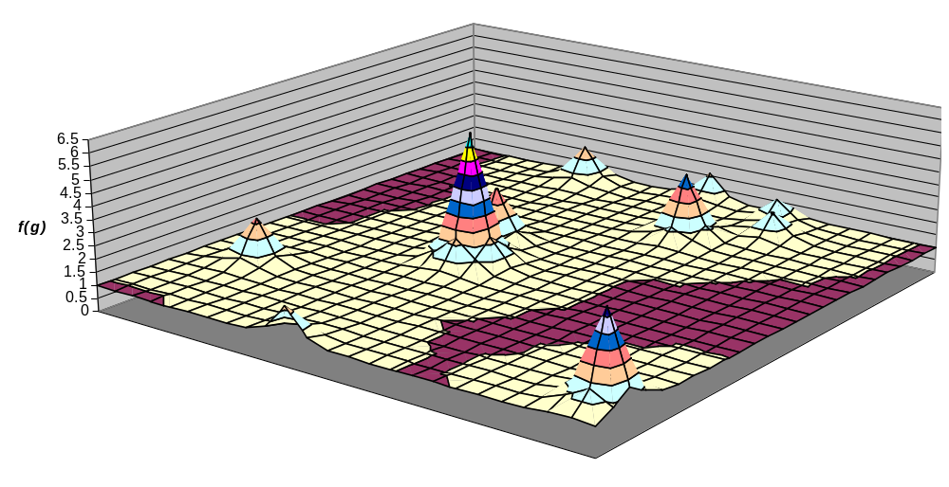
Example: Intra-gene landscape, multi-peaked
2D illustration using 10 randomly positioned peaks with a range of heights.
nucleotide
mutations
nucleotide
mutations

Slide 30
Example for two genes
…
…
No inter-gene epistasis

Slide 31
Some basic divide and conquer combinatorics
Suppose 20 genes of 20 bits each
  Search space of each sub-problem is 2²⁰ = 10⁶
Treating the problem in a monolithic fashion
  Total search space is 2⁴⁰⁰ = (10⁶)²⁰ = 10¹²⁰
  Cannot do this exhaustively
If we search each sub-problem exhaustively and put the sub-solutions together then total search is only 20.10⁶ = 2.10⁷
Note:
  If we could solve each sub-problem with a simple hill-climber (instead of exhaustive search) then 20 x time-to-solve-each-sub-problem is very small. But time to solve whole problem would also be trivial.
  But in this case, one run of a hill-climber would probably fail on any one sub-problem, and certainly fail on the whole problem. But if we have a few goes at each sub-problem that’ll solve each one reliably…

Slide 32
How to exploit this decomposition?
Each sub problem consists of 20 bits with intragene epistasis that creates multiple local optima
  (if it didn’t then solving each sub problem would be easy, and since each one is independent of the others, that’d mean solving the whole thing would be easy)
Finding the optimal genotype requires finding the optimal sub-solution for each of these sub-problems
With cooperative coevolution,
  We can use a separate population for each of the sub-problems
  And evaluate a sub-solution in a shared domain model with individuals from the other populations
But, aren’t these just building blocks? Isn’t sexual recombination (crossover) supposed to be able to solve problems like this?

Slide 33
In this problem
Asexuals
  see only the nucleotide-space fitness landscape
  For a given gene, some fraction p of individuals will find fitter alleles than others
  Any given individual will not possess the best available alleles at all loci – P(best possible indiv)= p^{#genes}
  Further fitness improvement requires multiple and specific point mutations simultaneously (or evolution against selective gradients)
  i.e. asexuals “cannot” evolve fittest genotypes
Sexuals
  Can select on good alleles independently
  (Much like Fisher/Muller model except here the introduction of intra-gene epistasis means that asexuals are effectively permanently stuck on inferior genotypes)

Slide 34
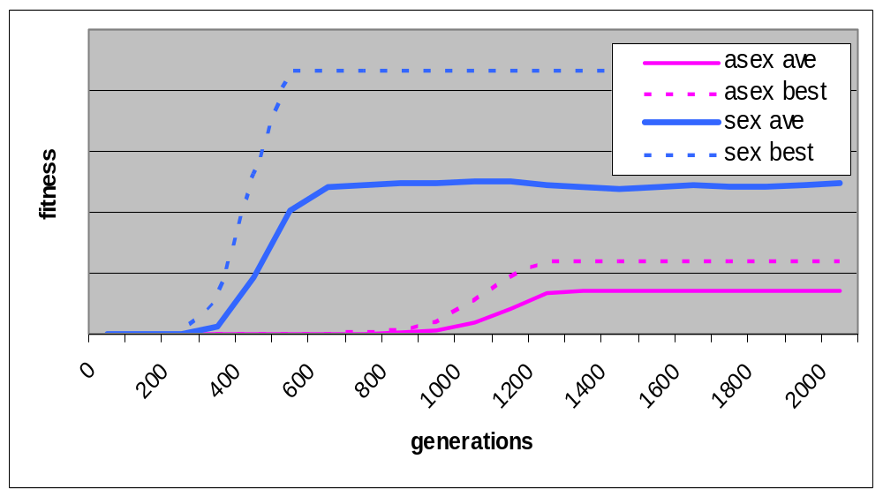
Results
Population subdivision supports allele diversity

Slide 35
…
I showed a trivial example of an easily decomposable problem
We could solve this with cooperative coevolution
We can also solve this with a regular (ish) GA and appropriate crossover
  Needs appropriate crossover method
  Needs appropriate population diversity
So, that means that a GA with crossover is more or less equivalent to ‘cooperative coevolution’!?

Slide 36
Next time
Can a problem that has sub-parts that are NOT completely independent be usefully decomposed?
Next time we look at types of modularity, including:
  Non-separable modules
  Hierarchical modularity
Later lecture: Compositional Evolution
  An approach to solving hierarchical modularity

Slide 38
Discussion
Is hill-climbing on bits to find alleles PLUS hill-climbing on blocks to find genotypes = “hill-climbing”?
Is it gradualist? Does it provide large, directed changes in genotype that are adaptive?
Compare with selection at either one scale alone
Selection on bits, then combinations of bits
  Should this continue through successively larger combinations?
In a sexual population, are genes coevolving?
How would cooperative coevolution of genes be different from sexual popn with uniform xover of genes?

Slide 39
Vertical vs horizontal transmission
Vertical transmission
  Parent to offspring
Horizontal transmission
  To an individual that is not a descendant
What is the reproductive unit?

Slide 40
Conclusions of separable blocks model
Previous models for the benefit of sex treat alleles as particulate units, abstracting away their nucleotide composition.
But recombination scales-up the variation unit ~1000-fold wrt mutation – encapsulating all that detail, and searching combinations of alleles instead of continuing search in nt-sequence space
The fitness landscapes at these different scales are likely to be very different
Genes are groups of tightly linked and epistatically interdependent nucleotides
This most basic feature of genetic architecture may be sufficient to confer a significant advantage to sexual populations.

Slide 41
This example has separable modules
Either sex or coop coev can solve this type of problem IFF the decomposition is known
But the real problem for the engineer is, how to exploit decomposability when
  decomposition is not known
  Inter-module dependencies have strong effects on fitness

Slide 42
Next lecture = CW assignment ‘surgery’

Slide 43
Summary of models for the benefit of sex
In EB
  None show a problem that cant be solved w hillclimbing (just slightly better hillclimbing)
In EC
For uniform crossover: (exp(k) vs exp(N))
  jump/gap,
  Hurdles/two-wells
For tight-linkage: (exp vs poly)
  HIFF
  Jump/gap++
  Two-modules
  Separable BBs (exp(sqrt(N)) vs poly)
    -> see gecco 2007 and Evolution 2011

Slide 44
Algorithms that discover modularity/automatic problem decomposition
Inversion operator
Linkage learning GAs (Harik 1990s)
Messy GA (Goldberg 1991)
Model-based opt: EDAs (Pelican 2002ish) eg PBIL, BOA
BBHC (Iclanzan 2007ish)
Hopfield network models (rHN-G) (Watson et al)
‘MACRO’ (Mills 2010)
Linkage Tree GA - Theirens
Schema Grammar – Cox
Deep optimisation – Watson (work in progress)

